Slide 1

Neuromend
By Tempest
An ICT313 Games Technology Project
Murdoch University
Ary Bizar, Anopan Kandiah, Hannah Klinac, Alex Mlodawski, Bryan Yu

Slide 2
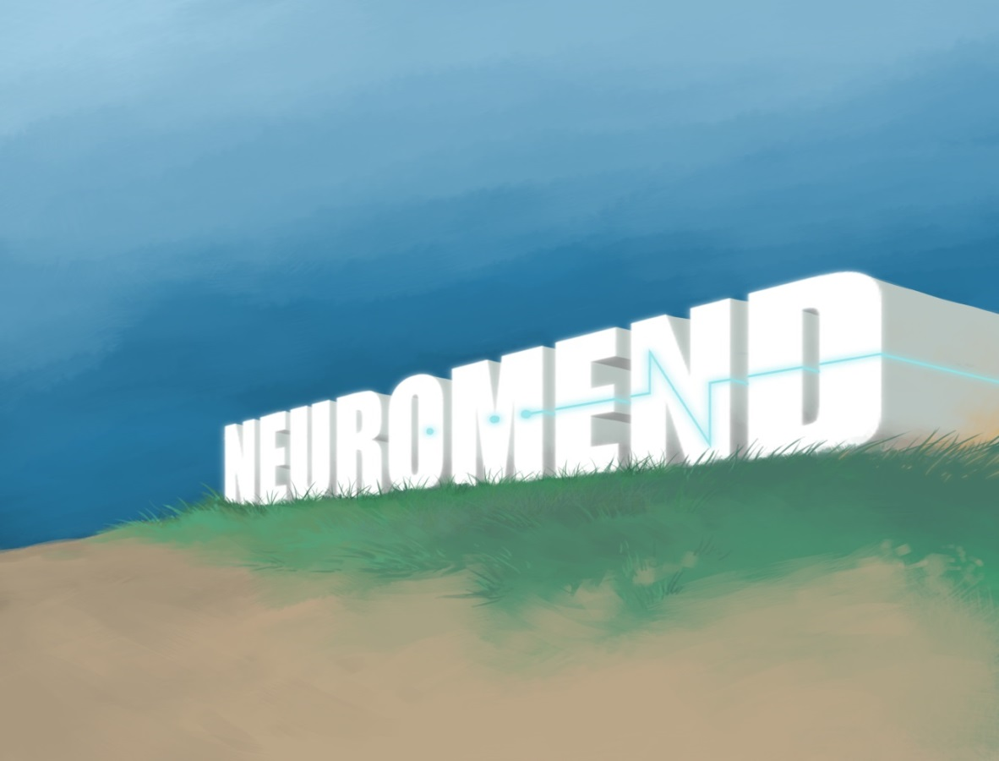

Outline
Introduction
Project background
Project requirements
The solutions
Our approach
Live demonstrations
Final status
Future possibilities
Lessons learned
Questions?

Slide 3
Project Introduction
Project Name: Neuromend
Client: Mr Shri Rai, Murdoch School of Engineering & IT
Supervisor: Dr Fairuz Shiratuddin
Tempest:
Ary Bizar (BSc, Games Technology; BA, Games Art and Design)
Level designer, Asset creation
Anopan Kandiah (BSc, Computer Science, Games Technology)
Kinect development
Hannah Klinac (BSc, Computer Science, Games Technology)
Leap Motion development, Project Manager
Alex Mlodawski (BSc, Computer Science, Games Technology)
Kinect development
Bryan Yu (BSc, Computer Science, Games Technology)
Razer Hydra development, Database

Slide 4
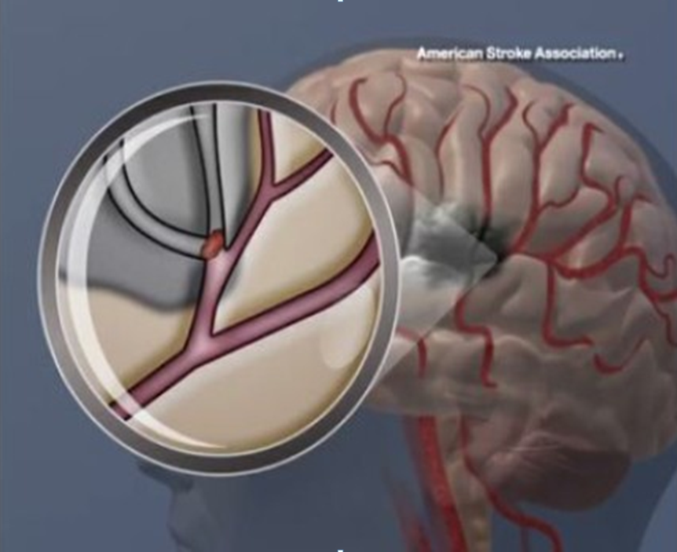
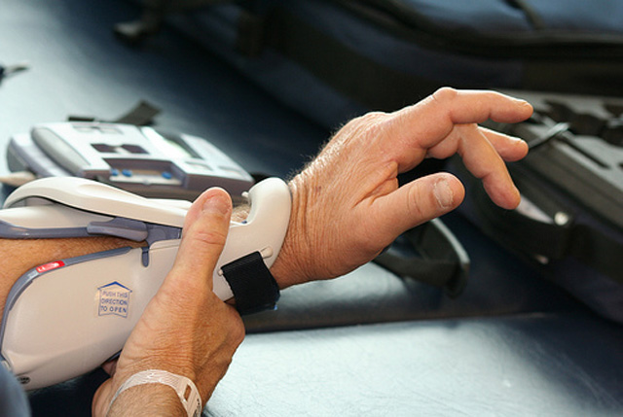
Project Background
Stroke
Parts of the brain may be damaged or may die
This can result some loss of motor control,
sensory, and cognitive abilities.
One form of rehabilitation is rewiring
Rehabilitation
Accessibility
Money
Tedious/boring
No incremental goals
Limited
Notes:
HELPING PEOPLE

Slide 5
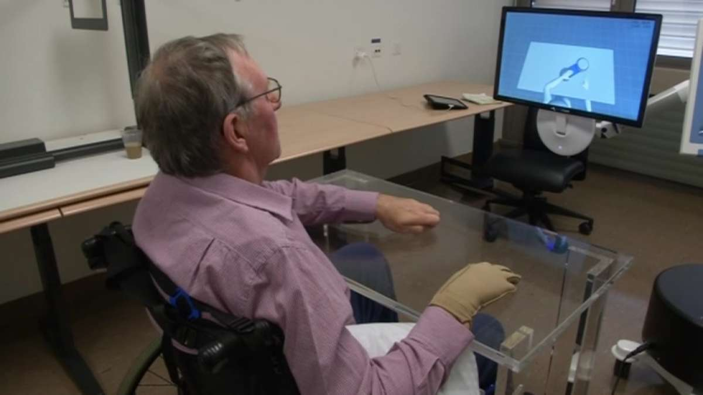
Project Specifications & Requirements
Specifications
This idea of simulation rehabilitation inducing rewiring is a theory that has been shown to work elsewhere
This project is one of the first steps toward establishing a stroke rehabilitation system
This project involves developing the prototype platform
Testing will be done next semester
Requirements
Create a virtual simulation
Design and develop 3 different tasks
Utilize natural user interfaces devices
Design and develop sensitivity adjustor
Design and develop to support profiling and database
to keep track of progress
Notes:
Project was initially created to evaluate the devices to see what could work well for a solution
Determined that the project was useful enough to be used in a practical setting
This project is essentially an evaluation step towards a more concrete implementation

Slide 6
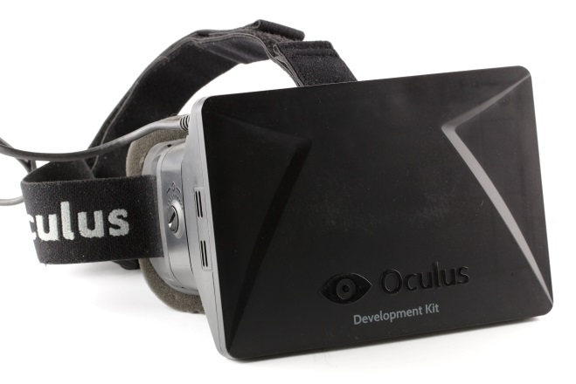
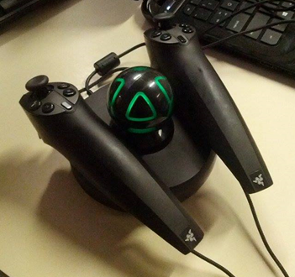
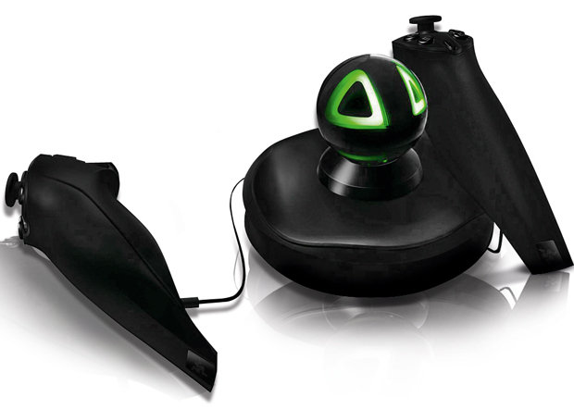
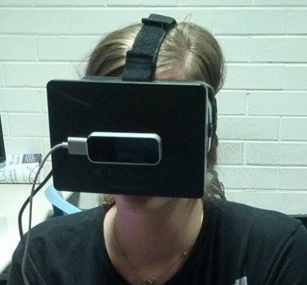
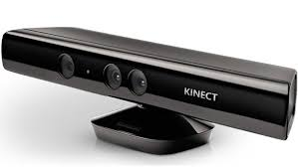
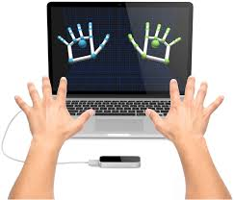
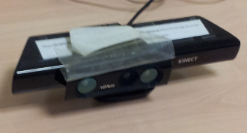
The Solutions
The main system must have:
Virtual environments
3 different tasks that require different movements
Object Manipulation
Obstacle Avoidance
Way Finding
Natural user interfaces* devices (providing different accessibilities) used in conjunction with Oculus Rift (the main display)
Keyboard and mouse* (control device)
Razer Hydra
Kinect
Leap Motion
Sensitivity and other adjustable settings
Provide incremental goals
Monitoring progress – can be assessed
Profiles on an external database

Slide 7
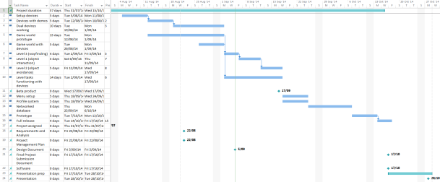
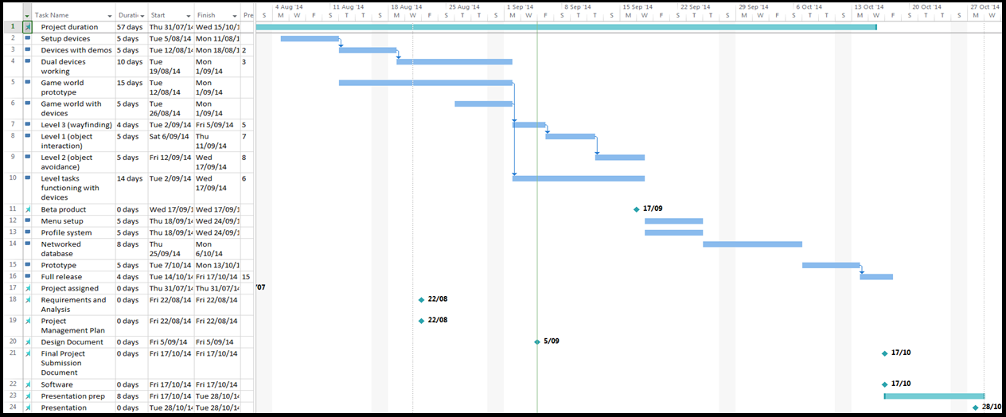
Project Management
Iterative (SCRUM) methodology with weekly sprints
Weekly team/supervisor meetings
Communication
Project room
Facebook group
Source code control
GitHub
Notes:
Weekly team meetings: discussed requirements, issues and demonstrated progress and prototypes
*How the project was managed
*How the team was managed
Work breakdown
Work assignment

Slide 8
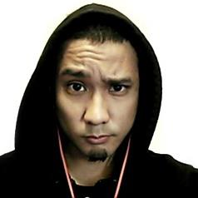
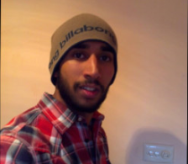
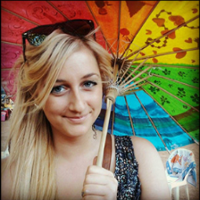
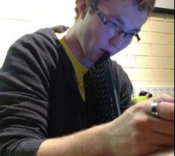

Project Management - Team
Ary Bizar : Level designer, Asset creation, Mouse & keyboard development
Anopan Kandiah : Kinect development
Hannah Klinac : Leap Motion development, Project Manager
Alex Mlodawski : Kinect development
Bryan Yu : Razer Hydra development, Profiling and Database
Notes:
Work breakdown
Work assignment

Slide 9
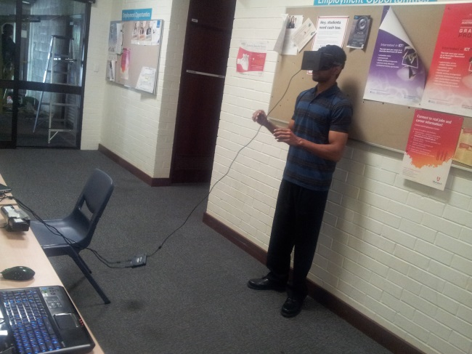
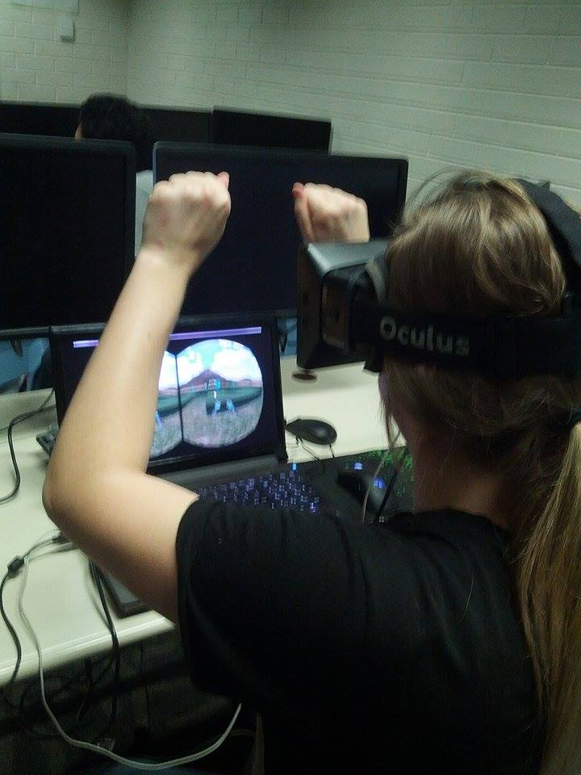
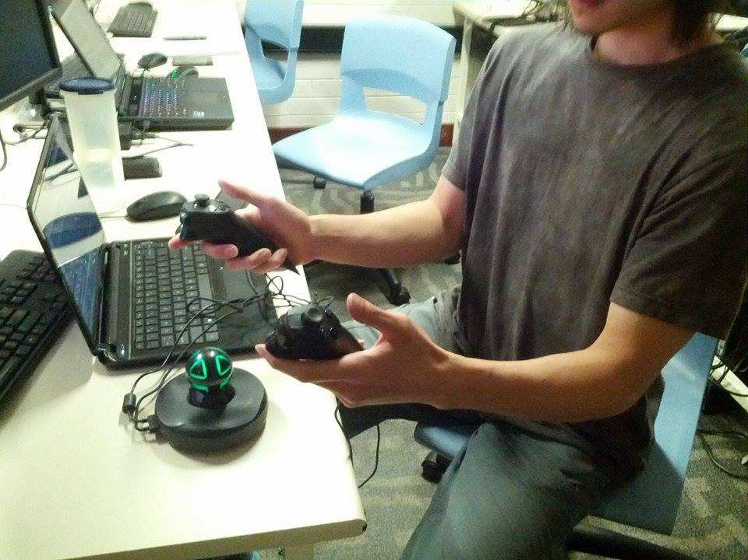
Technologies Utilized
Main system was developed using Unity and coded using C#
Visual assets
3DS Max
Mudbox
Photoshop
Database and profiling system
MySQL
ClearDB
Hardware
Oculus Rift DK1
0.4.0 SDK
Razer Hydra
Sixense SDK
Kinect v1 for Windows
V1.8 SDK
Leap Motion
V2 Tracking API, 2.1.5 SDK

Slide 10
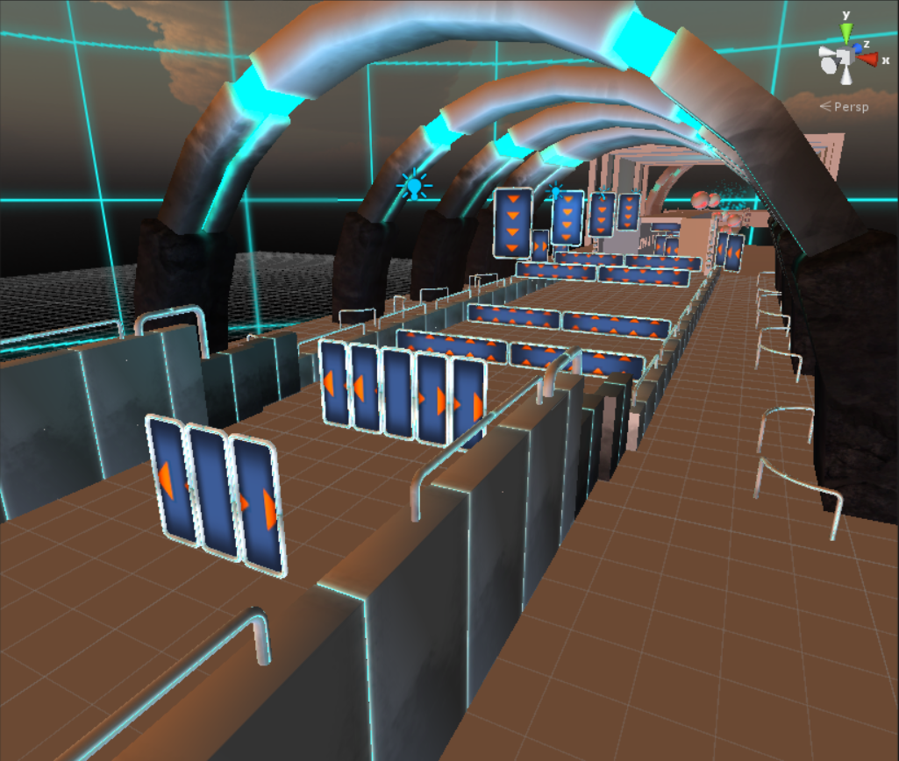
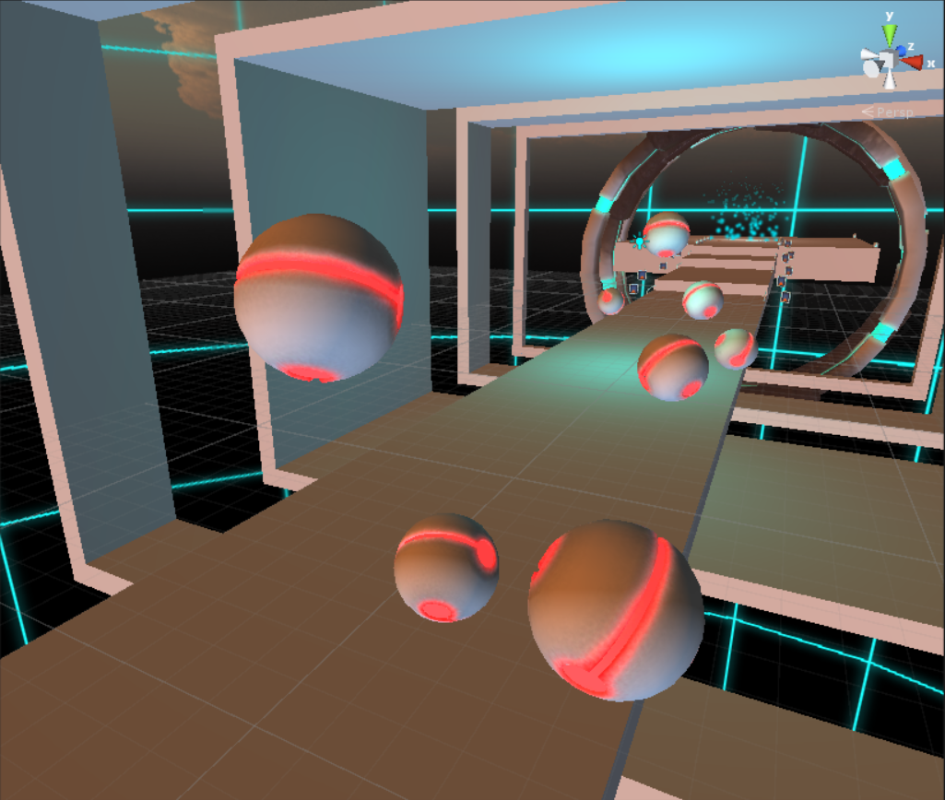
Live Demonstration Kinect – “Obstacle Avoidance”
Obstacle Avoidance Exercise
Reactions
Decision making
Constant forward movement
Kinect actions
Tracks full body
Actions using arms and hands
Usable by able bodied
Adjusts heightened sensitivity

Slide 11
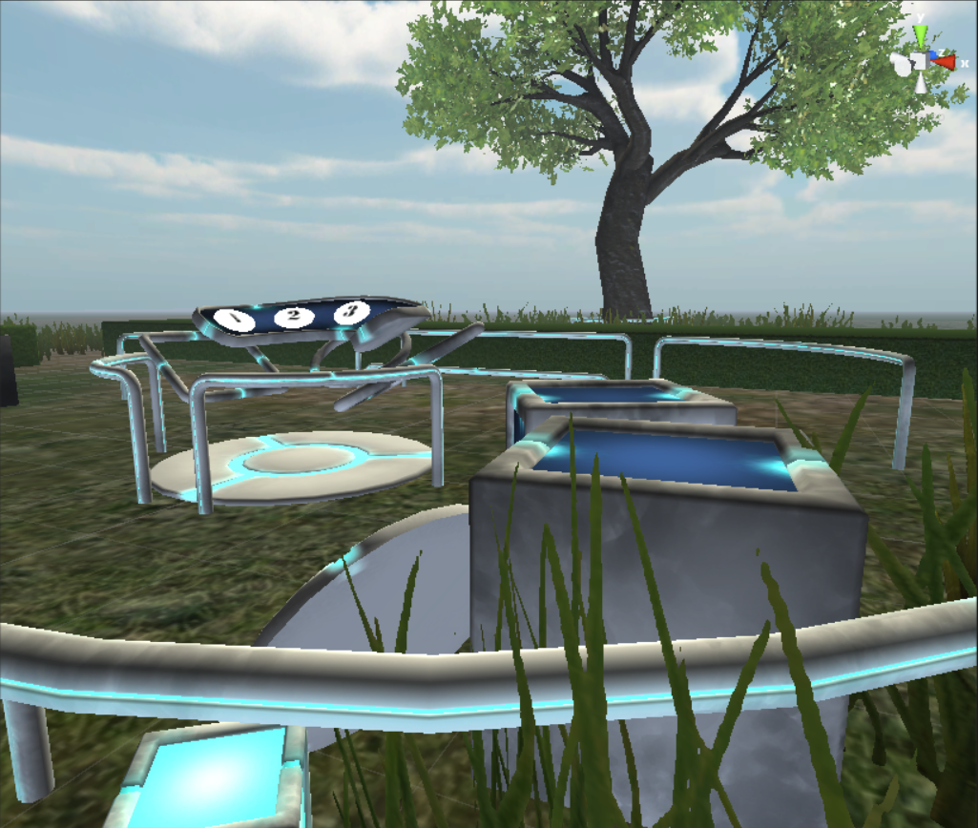
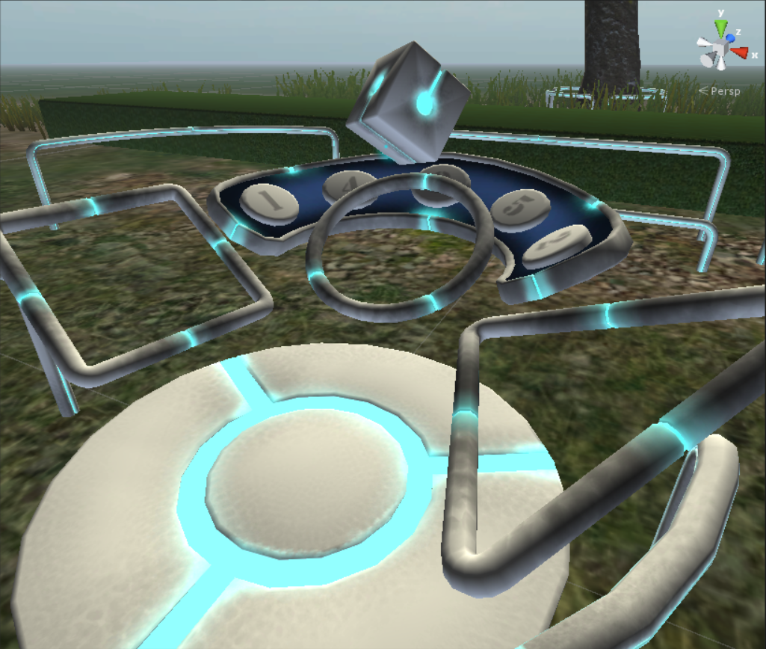
Live Demonstration Razer Hydra – “Object Manipulation”
Object Manipulation Exercise
Simple puzzle solving
Order
Association recognition
Stationary user position
Razer Hydra actions
Sixense technology
Tracks hands
Triggers and joysticks
Tracks position and orientation
Usable by able bodied
Adjusts heightened sensitivity

Slide 12
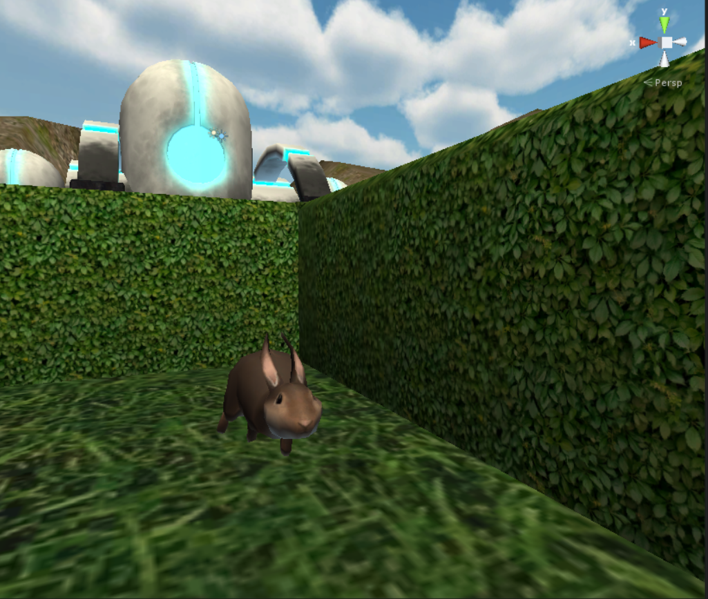
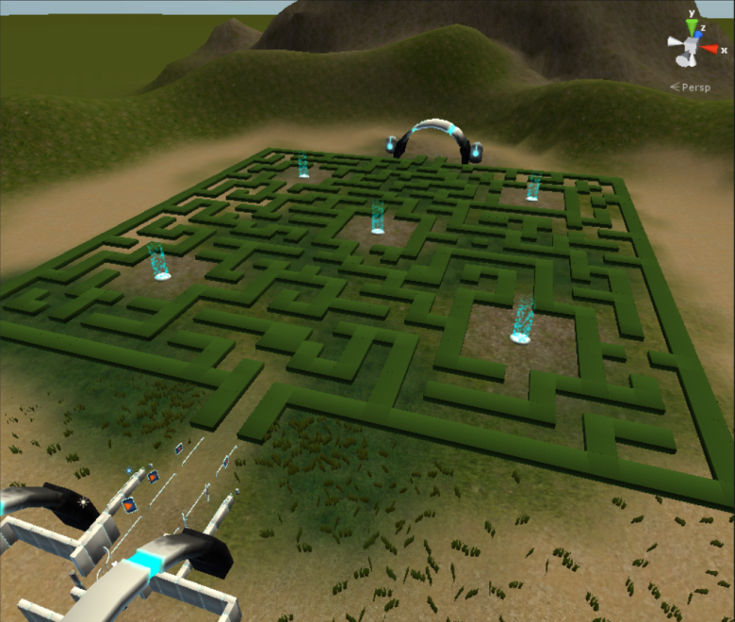
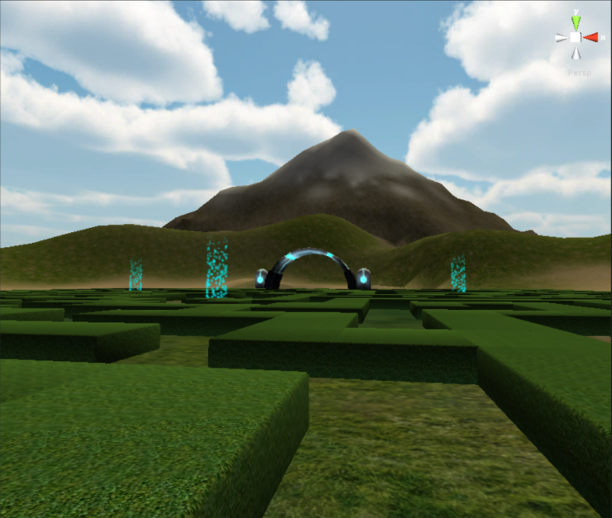
Live Demonstration Leap Motion – “Way Finding”
Way Finding Exercise
Memory
Sense of direction
Maze hints
Rabbits
Jump pads
Points of reference
Leap Motion actions
Beta product
Tracks hands using near infra-red frustum
Actions using hands in the interaction area
Tracks all 10 fingers up to 1/100th of a millimetre
Usable by able bodied
Adjusts heightened sensitivity

Slide 13

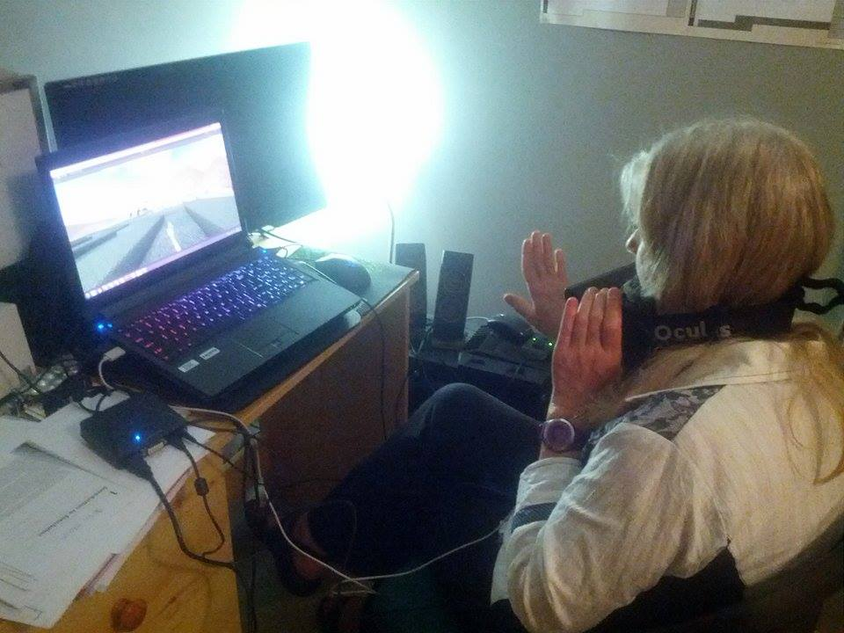
Final Status
Requirements
Virtual Simulation
3 different tasks
NUIs Devices
Sensitivity adjustor
Profiling
Database
Playable by anyone
Interesting and enjoyable
Extensible
The project is now in a position to be extended for deployment into practical use

Slide 14
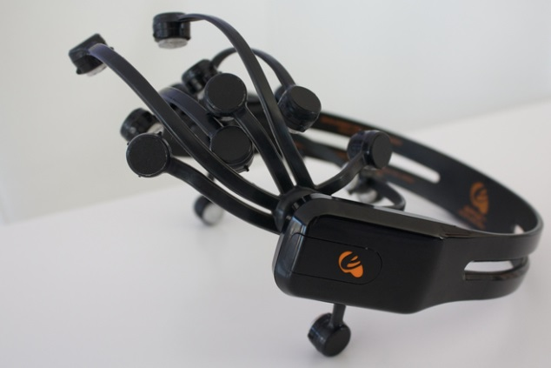
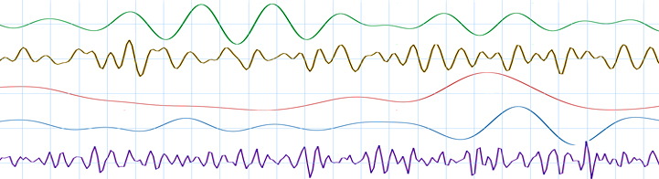
Future Possibilities
Clinical use
The system will be tested soon
Additional control schemes
Speech
Electroencephalogram (EEG)
Records brain wave patterns
Monitoring variables to self improve the system
Stress
Support for future versions of the NUI devices
Oculus Rift DK2
Kinect 2
Tobii EyeX (Eye Tracker)
Leap Motion release
Sixense Stem System (wireless motion tracking system)
Virtuix Omni (360° treadmill)

Slide 15
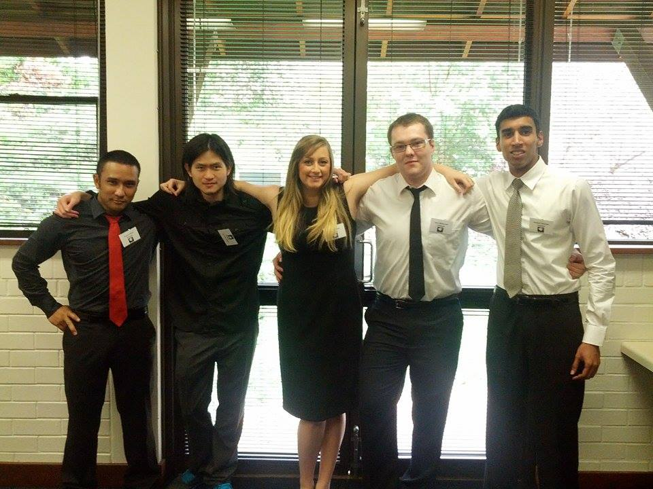
Lessons Learned
Devices
Beta products and development kits
Drivers clashing
Versions/compatibility
Designing the tasks and the movements/gestures to meet requirements and to also consider the devices and what they can do
Version control and modifying joint code
Teamwork
Decisions
Conflict resolution
Communication is essential for success
The importance of time management
Assess and managing scope

Slide 16
Acknowledgements
Client – Mr Shri Rai
Supervisor – Dr Fairuz Shiratuddin
Ayden-James Nolan – Music
Elly Thompson - Sounds

Slide 17
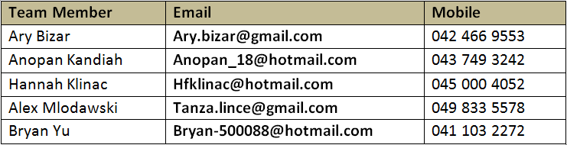
Questions?

Slide 18
References
http://images.sciencedaily.com/2014/08/140807163633-large.jpg
http://www.reuters.com/video/2014/03/26/virtual-reality-stroke-therapy-tricks-br?videoId=299126765
http://strokediseases.files.wordpress.com/2011/02/wpid-stroke-arm-rehabilitation.jpg
http://clearingwritersblock.com/images/brainwaves.jpg
http://www.wired.com/images_blogs/threatlevel/2012/08/eeg_headset.jpg
http://www.robotshop.com/media/files/images2/leap-motion-3d-motion-gesture-controller-10-large.jpg
http://upload.wikimedia.org/wikipedia/commons/a/ae/Oculus_Rift_-_Developer_Version_-_Front.jpg
http://me.ign.com/sm/ign_me/screenshot/w/win-a-razer-hydra-motion-controller/win-a-razer-hydra-motion-controller_2ubw.jpg
http://images.pcworld.com/images/article/2012/01/kinect-for-windows-8667082.jpg

